Slide 1









Pharmacy Management System
Presented To:
Dristi Saha
Lecturer
Department Of CSE,
Daffodil International University
Presented By:
Nurjahan Akther Mim 221-15-4782
Abu Zahed 221-15-4716
Md Amir Hamja 221-15-4784
Arnub Datta 221-15-4726
Section: 61_L Department Of CSE

Slide 2





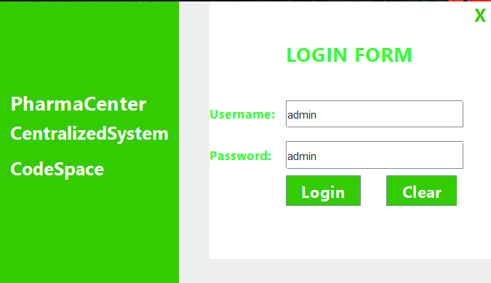


LogIn
Our Vision

Slide 3
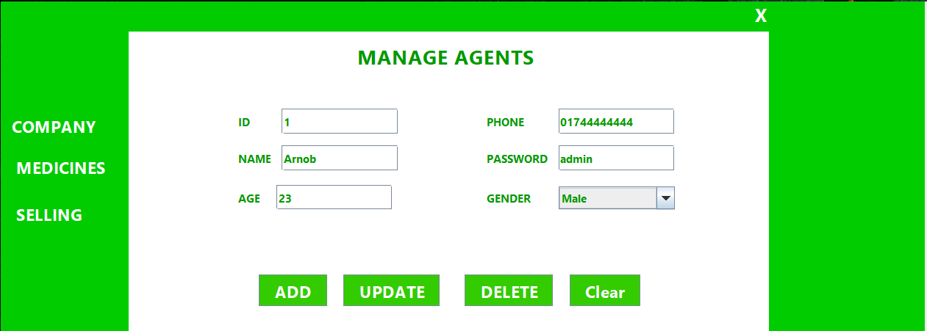
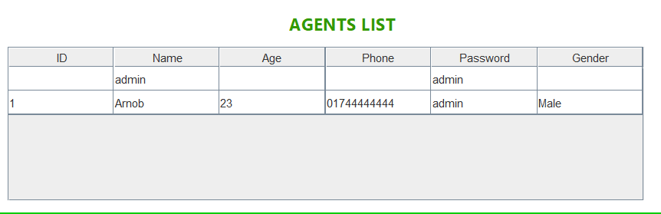
Agents Form

Slide 4
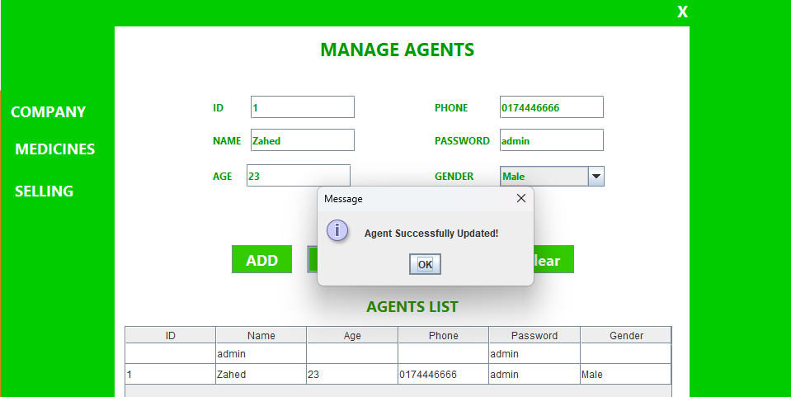
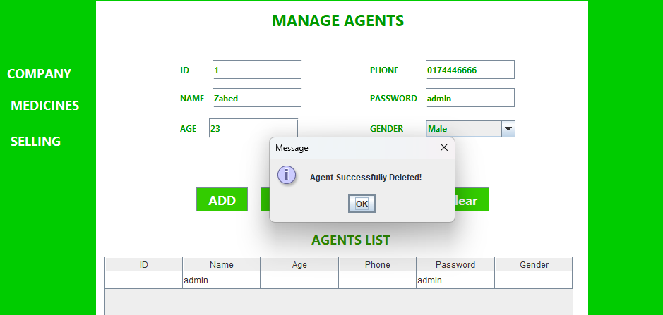
Agents Form

Slide 5
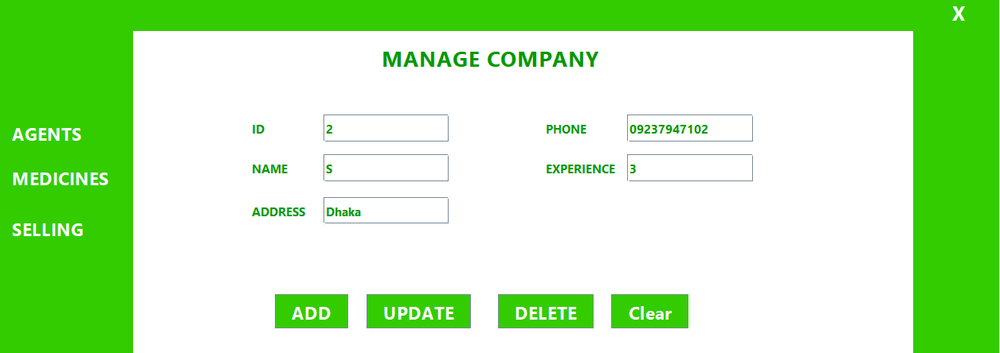
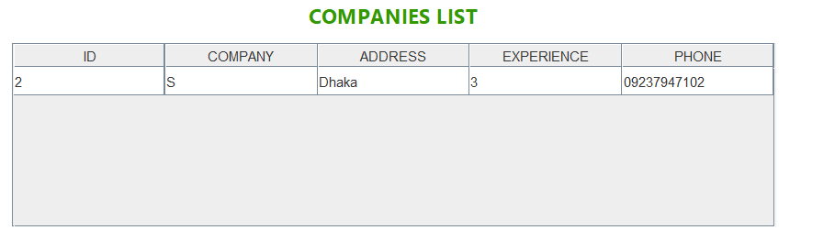
Company Manage Form
Our Vision

Slide 6
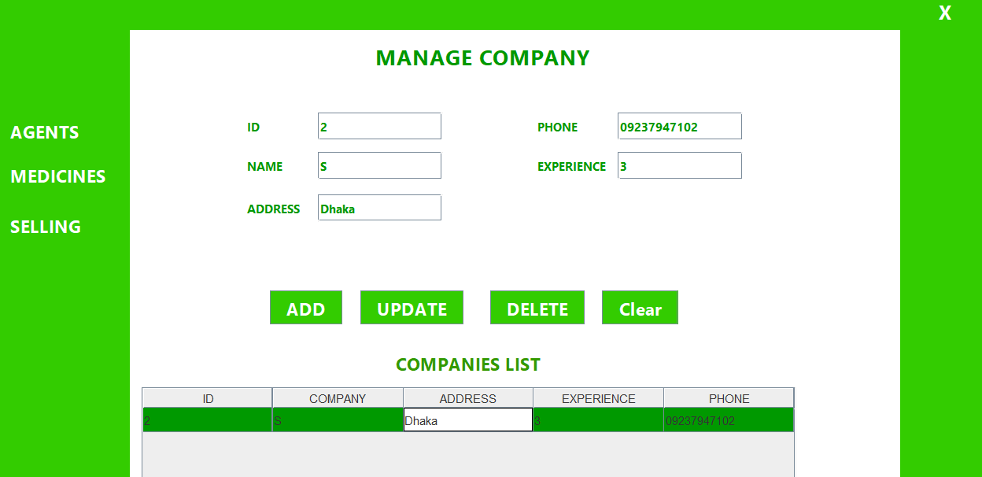
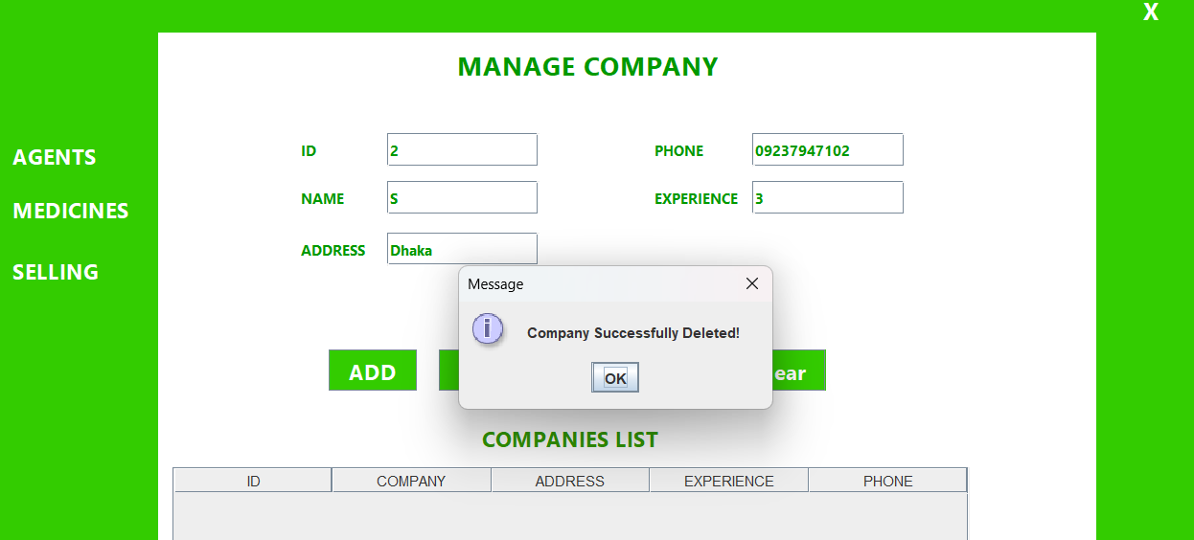
Company Manage Form
Our Vision

Slide 7
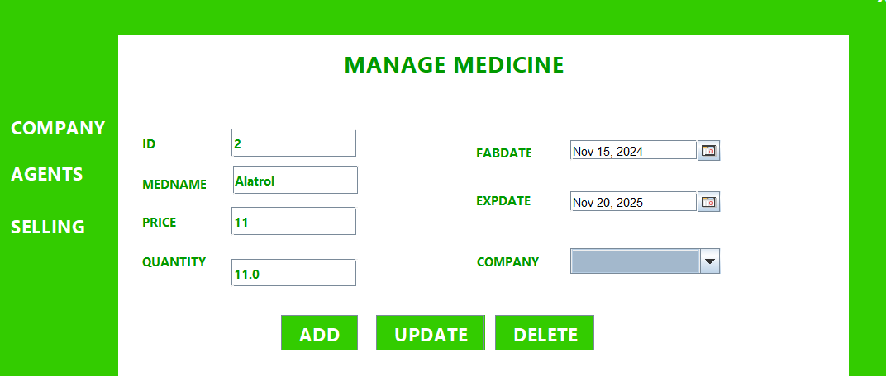
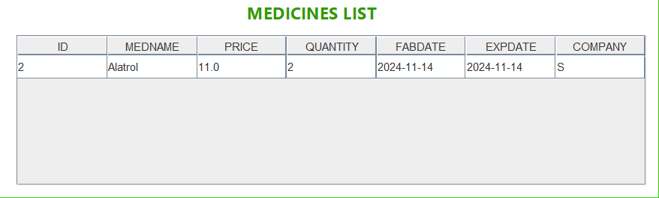
Medicine Manage Form

Slide 8
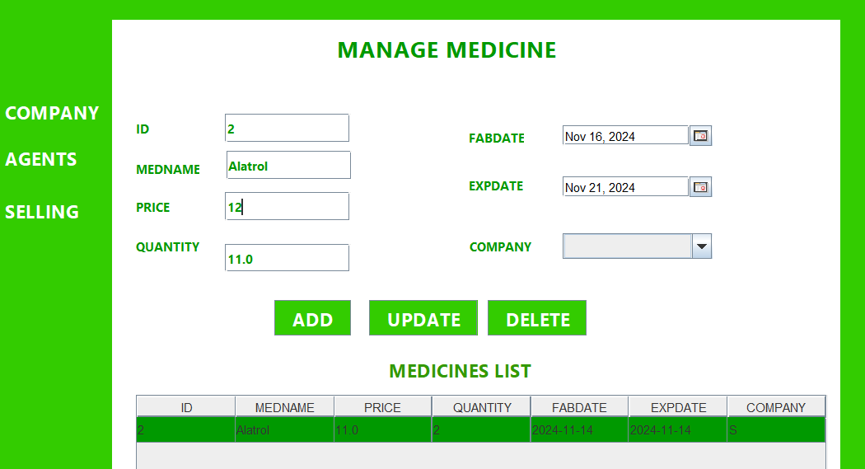
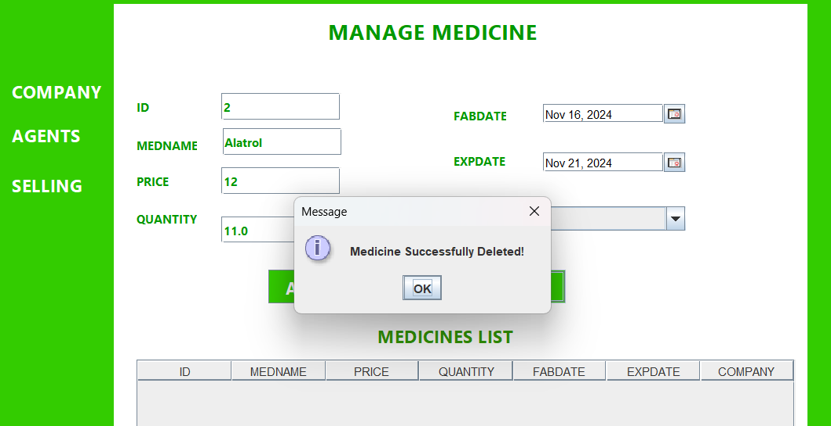
Medicine Manage Form
Our Vision

Slide 9
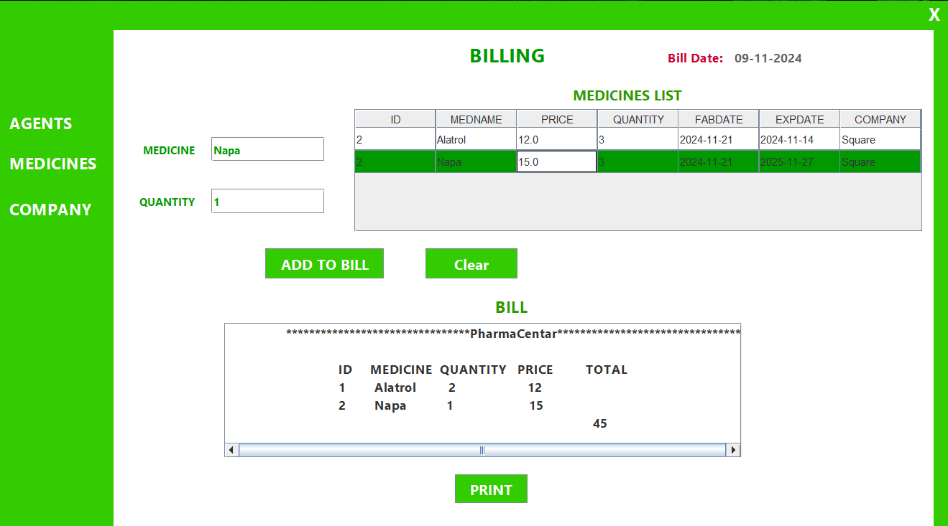
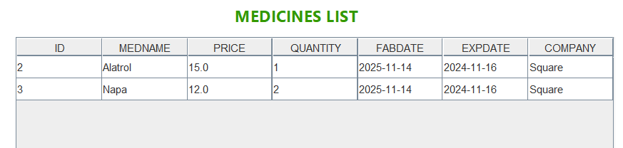
Billing Form

Slide 10


THANK YOU!😀

